Slide 2
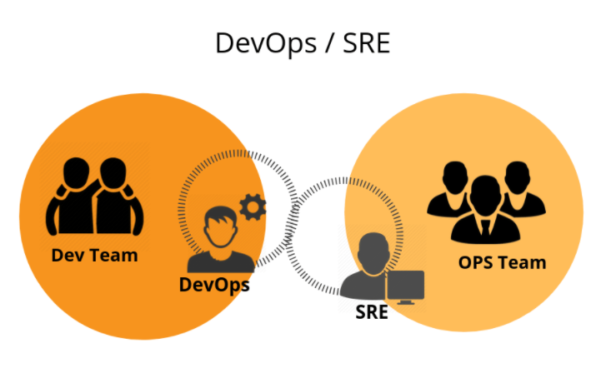
Confidential | Axiata Digital Labs
Version 1.0

Slide 3

Objectives of this Session
DevOps Or SRE ?
Dev-Ops/SRE Responsibility and Duties
SRE/Dev-Ops ?
Site Reliable Architecture
Proposed Tasks

Slide 4
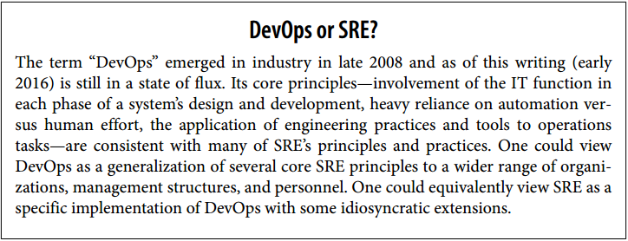

Slide 5
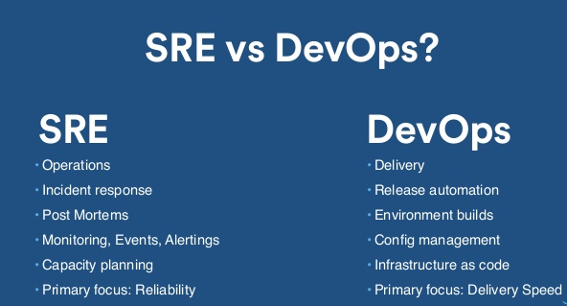

Slide 6
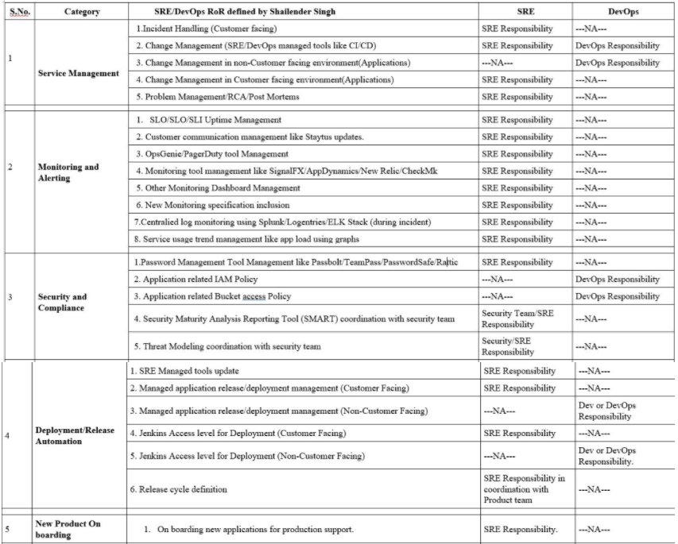
DevOps / SRE Responsibility and Duties
https://dialogsl.sharepoint.com/:w:/s/IOTDevops/EccL0BnKRA1Jmdg3DlYpJBgB3sCyhmasG-WmOlojbLh4HA?e=TJt3hM

Slide 7
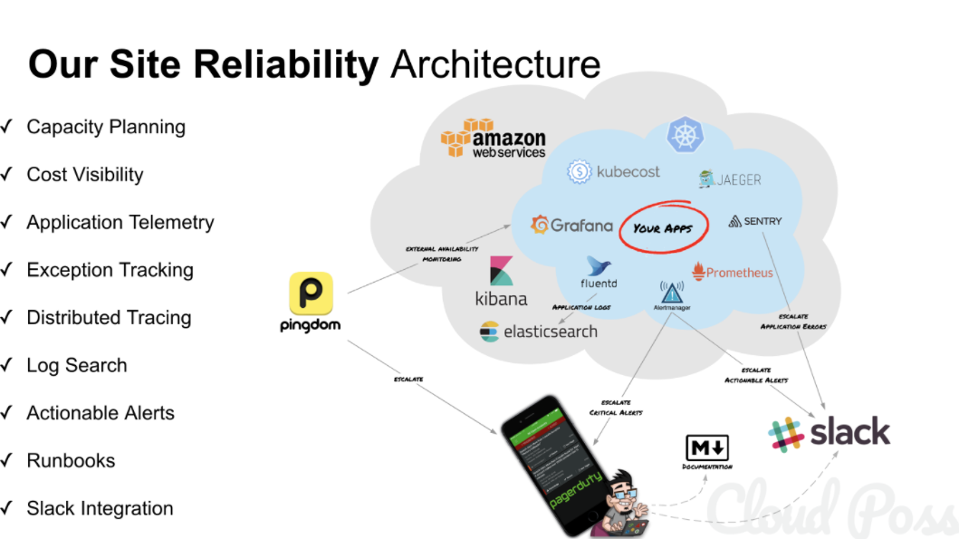
https://www.transposit.com/blog/2020.01.30-writing-runbook-documentation-when-youre-an-sre/

Slide 8
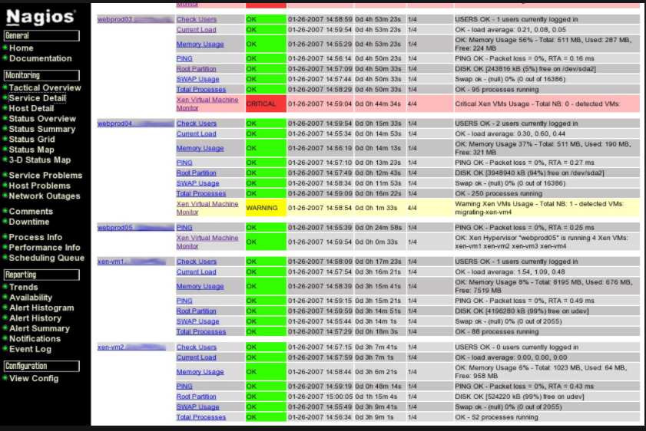
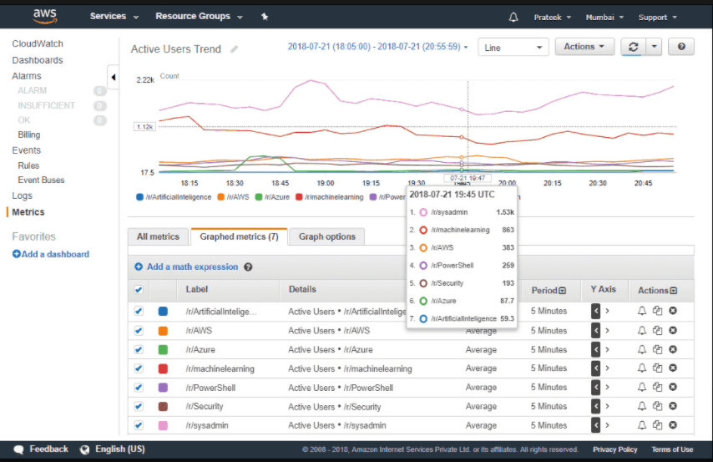
Monitoring Tools for platform
Nagios CloudWatch
Admin portal and Devportal

Slide 9

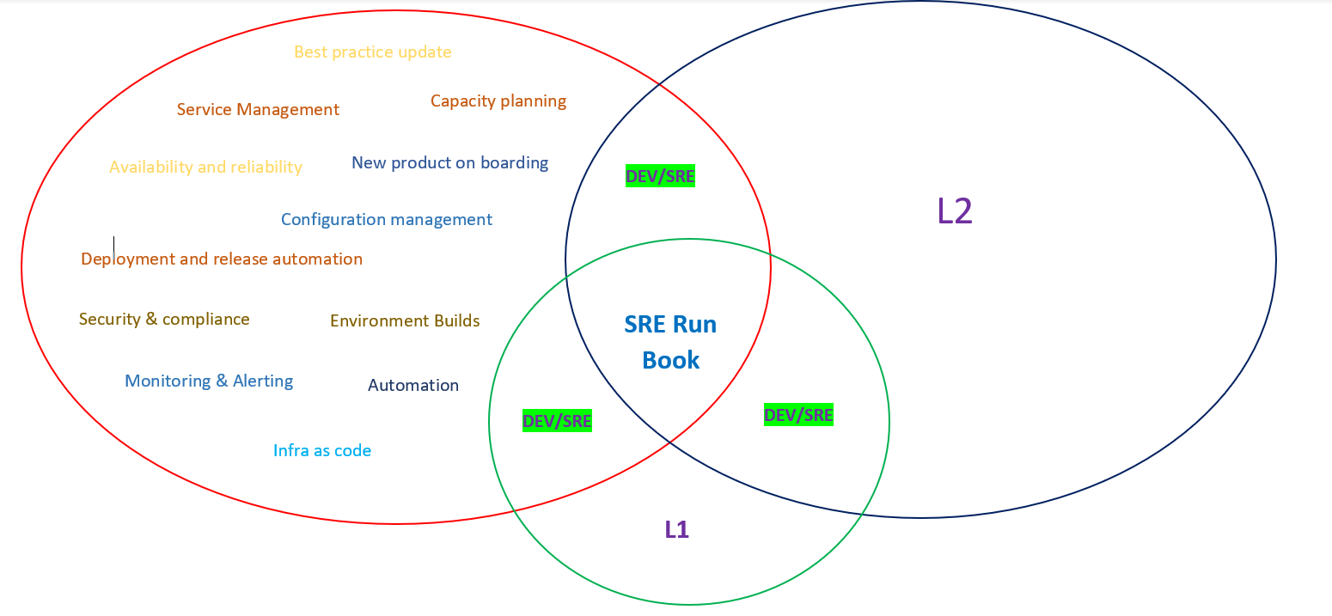
SRE Run Book >>>>>

Slide 10
Proposed Tasks
Dailey Monitoring Report
Confluence or SRE Run Book

Slide 11
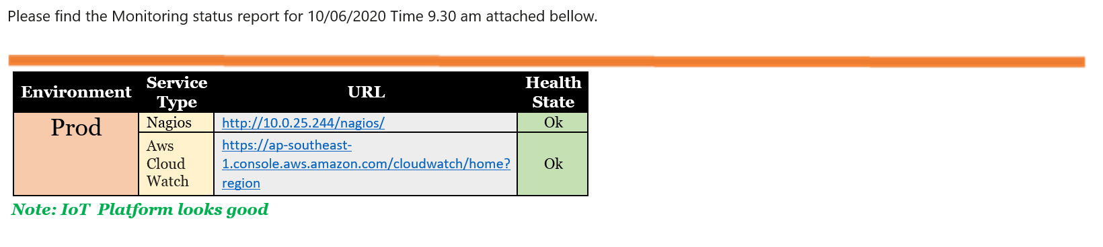
Dailey Monitoring Report
Others If some thing brake you can mention under others Colum

Slide 12
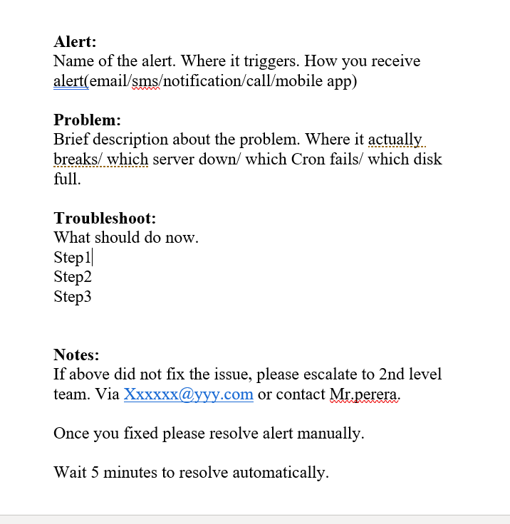
SRE Run Book

